Slide 1
Creating an Effective Research Poster -
Specifics for the July 25 Summer Undergraduate Research Symposium and General Tips
Summer 2019
Michelle Richards-Babb, Ph.D.
Professor & Director of the Office of Undergraduate Research, West Virginia University

Slide 2
Poster Abstracts for Booklet: Submit by 11:59 pm July 14!
Preparation instructions. Highlights…..
  Title (4-13 words): Concise, unique, bold, use keywords, perhaps describe results in title. Not too technical! (Avoid, “Effect of…”)
  Author(s): Include ALL authors who made substantial contributions
  Author Affiliation (byline): Dept/institute/university, city, state, zip where research took place (do not include street address)
  Abstract (150-175 words): Self-contained, single paragraph statement that allows reader to determine nature/scope of poster. Include…
        Problem statement/purpose of research (hypothesis/question addressed & motivation/impact)
        Research context (demonstrate attempt to make unique contrib.)
        Research methodology (approach)
        Summary of principal findings or expected results (results)
        Major conclusions
        Safety information (if applicable)
        Do NOT include references in your abstract!
Rank top three category choices for poster…..
  Biological Sciences, Health Sciences, Agricultural Sciences
  Environmental Sciences, Physical Sciences, Engineering, Nanoscience
  Neuroscience, Mathematics, Human Engagement
Submit abstract at: https://honorswvu.wufoo.com/forms/r1xq28oy0zpndxy/

Slide 3
How should I write the abstract if I do not have results?
For national/regional discipline-specific research conference, typically submit completed research.
For our institutional symposium, it is understood that your research may be in progress.
No results yet? Recommended language for abstract:
  “Preliminary results indicate that…..”
  “We expect our results to confirm…..”
  Be sure to check with your faculty research mentor.

Slide 4
When is/where is/who presents at the Symposium?
Thursday July 25, 2019 Approximate Schedule:
  8:30-8:55 AM Poster Setup - presenters put up posters by/before 8:55 AM and return during assigned, judged presentation time (TBD) sometime between 9:00-11:30 AM.
  9:00-11:30 AM Poster Judging - only scheduled presenters present & not open to public (all presenters return at 11:30 AM)
  11:30 AM-12:00 PM Break/Lunch (judges & presenters first)
  12:00-12:30 PM Welcome and Key Note Speaker – Dr. Earl Scime, Interim Dean, Statler College (All are welcome!)
  12:30-2:30 PM Poster Presentations - open to general public and concurrent with final poster judging (All welcome!)
  2:30-3:00 PM Awards Ceremony and Closing Remarks
  3:00 PM Poster Take-Down - any posters remaining after 3:30 PM will be removed by staff
  3:05 PM Post-questionnaires (REU/SURE participants)
Ruby Grand Hall, Erickson Alumni Center, WVU Evansdale Campus
UG researchers from many different programs will present!! 90+ presenters!

Slide 5
What should I do during the poster presentation?
Poster presentation
  stand by/near your poster
  engage people/judges in conversation
Be ready to give an overview of your project (4-5 min. max) using your poster visuals.
  Start broad (w/impact), then move on to more focused information.
  Non-expert should be able to understand!
  Avoid jargon/acronyms!

Slide 6
What should I include in my project overview?
    In the overview you should display:
      Project knowledge (Main focus of research? Importance/impact? Conclusions?)
      Logical presentation (Clear/coherent? Refer to poster visuals?)
      Background information/understanding (as evidenced by ability to explain project)
      Presence (Speak clearly? Make eye contact? or Read from poster?)
      Ability to answer questions about your research (evidence of project knowledge)
Practice your poster presentation and limit to 4-5 minutes!!

Slide 7
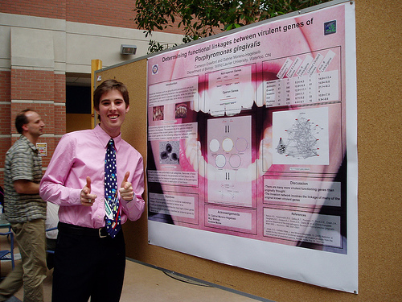
How should I dress? Dress to Impress!! Business casual, at minimum.
*photo by Nicole Barker: obtained from http://www.flickr.com/groups/postersessions/

Slide 8
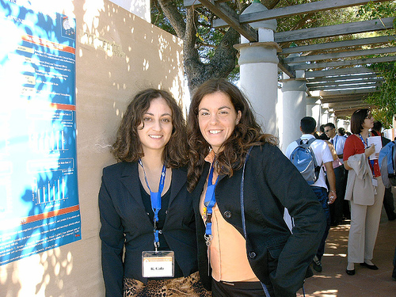
*obtained from http://www.flickr.com/groups/postersessions/

Slide 9


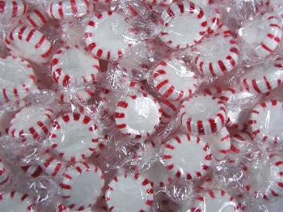
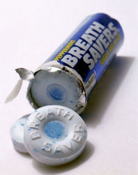


Brush and Use Breath Mints!

Slide 10
What are the goals of a research poster presentation?
Stimulate interest in your research
Receive feedback on your research
Network: generate contacts
  expansion of research
  job opportunities
    include your email on the poster and provide poster handouts

Slide 11
How do I attract people to my poster?
To get attention & to capture attention from afar…
  use visually appealing layout of information, colors, and fonts
  invite people over if they seem tentatively interested
To keep attention…
  give a clear, logical, and interesting presentation of your research
  include only necessary information, focus on data
  use abbreviated writing style (i.e., omit non-essential words
Poster should NOT be enlarged version of written report!!

Slide 12
Poster Size? (Two posters per board and boards are 46 inches height by 6 ft width)
Maximum size of poster:
Poster layout must be
portrait mode!! →
Paper typically limited to 36” (35” image) or 24” (23” image) width but any length so poster. You will most likely print with 36” paper as:
Be aware of ½ in margin on each edge. Take this into account!
Poster Title
Author(s)
Byline
Poster
Components
46 inches
in height max
36 inches (3 ft) in width max
Poster Title
Author(s)
Byline
Poster
Components
length/height →
36 in
46 in

Slide 13
How do I prepare my poster?
Use Microsoft PowerPoint or Publisher (or other presentation software). However, Microsoft products compatible with WVU computers.
  PowerPoint
    Go to Design and then Slide Size - Custom and change width, height, and orientation of page (e.g. width=36”, height=46”, & orientation = portrait)
    Click View followed by Zoom to zoom in (10% gives picture of overall poster on screen) and out (100% gives actual size of text) as you prepare the poster.
  Publisher
    When first open click on More Blank Page Sizes, then Custom, Create New Page Size (or just go to Page Design and change page size) and change page size to width=36” and height=46”.
    Zoom in (10% gives picture of overall poster on screen) and out (100% gives actual size of text) as you prepare the poster.
    Plotter has tough time with gradient and/or busy backgrounds. Avoid!!

Slide 14
Where do I print my poster?
WVU Evansdale Library (basement of Evansdale Library): During normal business hours (M-Th: 9 am-6 pm, F: 9 am-5 pm). More information? Call (304)293-2900.
Health Sciences Library: Printing available during regular business hours. Go to Access Services desk to print a poster. More information? Call (304)293-2113.
  WVU Downtown Campus Library (Lower Level): During normal business hours. (M-Th: 7:30 am-7 pm, F: 7:30 am-5 pm). More information? Call (304)293-0362 or see https://lib.wvu.edu/services/printing/poster/.
  WVU Departments: Many Departments (Biology?) and Colleges (Statler, Health Sciences) have their own large format printers. Ask your faculty mentor.
  You can print your poster in semi-gloss or matte. Semigloss does not fade, but does run when wet.
Do NOT begin poster printing less than 30 minutes before close!!

Slide 15
  Where do I print my poster (cont.)?
Other, more expensive, places to get your poster printed, if desperate…..
  Morgantown Printing & Binding, Inc. Office Depot Morgantown Blueprint
  morgantownprinting.com (304)598-7899 (304)292-6030
  (304)292-3368 limited to 24” width $36-$60
Have your poster ready to print out when you get there!!
Do NOT wait until the last minute! There will be 90+ other students trying to get their posters printed at the same time. The sooner your poster is printed the better!
Fabric Posters - New Poster Medium! Ease of use when traveling, but expensive and need lead time for shipping. If interested see postersmith.com and spoonflower.com.
See: https://support.spoonflower.com/hc/en-us/articles/204266984-How-to-Create-a-Fabric-Presentation-Poster-from-a-PowerPoint-or-PDF

Slide 16
How much does it cost at a WVU Site and how do I pay?
Cost of poster printing is < $2/sq ft (reasonable size poster).
Put enough money on your student ID to cover poster printing and take ID along when print out poster.
Save poster (PowerPoint/Publisher version & pdf version) to USB drive or send it to your email. Take USB drive to poster printing venue or login in to email and staff will assist you in printing out your poster.
Once poster is sent to large-format plotter, you will swipe your student ID, select your poster, and money will be deducted from your student ID.

Slide 17
What components should I include on my poster?
Poster judging rubric attached. Include…..
  Title: from abstract
  Author(s): from abstract (no Dr./Prof. titles)
  Byline/Author Affiliation: from abstract
  Poster Body
    Hypothesis/goals/problem statement (What’s the question?)
    Motivation/purpose of research/broader impacts (Why care?)
    Background information (limited and as needed)
    Theoretical or Experimental Plan/Methods (Approach?)
    Data/results (What did you find?)
    Conclusions (What do your results mean? Did they answer the question?)
    Future work/directions (Next steps?)
    References (if needed, 5 or fewer, shorten, on bottom)
  Acknowledgements (Who funded/helped with work?)
Typically, do NOT include the abstract on your poster!!

Slide 18
Guidelines of Poster DOs…
Colors
Use light background with dark lettering. Uses less ink and more readable.
Limit to 3-4 compatible colors
Use text colors consistently (e.g., main headers in dark blue, subheadings in tan, rest of text in black)
Text
Left justify most text except title/author/affiliation
Use bold, italics, underlining consistently, but sparingly
Use easy to read fonts…Times New Roman (text) or Arial (headings/title)
Use large font size
  Title 72 point (visible 15 ft away)
  Author/Byline 48 point
  Headings/Subheadings 44 point (visible 6-7 ft away)
  Text 32 point (visible 3 ft away)
Minimize complete sentences
Make title/headings compelling/attention grabbing similar to a newspaper headline.
State results explicitly in headings (e.g. Results: Rats ingesting pot live longer!). Attracts attention from far away.
(Not red on black)
(Not green w/red)
  HINT…Print out a “handout” version on an 8 1/2” x 11” piece of paper. If text
  is unreadable on handout, then text is too small. Increase the font size.

Slide 19
Guidelines of Poster DOs (cont)…
Layout
Arrange top to bottom then left to right
Use bulleted/numbered lists for methods/conclusions
Include some white space
Use arrows or numbered headings to direct reader
Use symmetric arrangement
Use good balance of graphics and text
Graphics
Viewable 3 feet away at a minimum
Use heavier lines to improve viewing
Text should support graphics (not vice versa)
Limit rows/columns in tables (> 20 table cells overwhelms)
Limit bars on graph (6 or fewer) or lines (3 or fewer)
On separate graphs: use same scale (especially for comparisons)

Slide 20
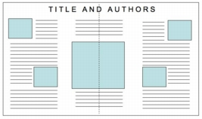
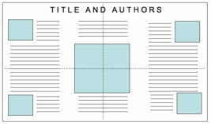
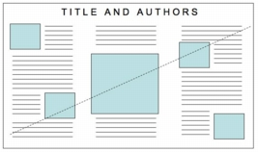
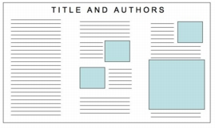
Make visually appealing!!
Good Layout: Vertical Symmetry
Good Layout: Horizontal & Vertical
Symmetry
Good Layout: Diagonal Symmetry
Poor Layout: No Symmetry & Text Heavy
*Obtained from : Hess, G., Tosney, K., and Liegel, L. Creating Effective Poster Presentations,
http://www.ncsu.edu/project/posters/NewSite/CreatePosterLayout.html.

Slide 21
Guidelines of Poster DOs (cont)…
Graphics
Use graphics over text whenever possible
Images/graphs > flow charts (e.g., for methods) > tables > bullet lists > text
Pictures – use jpeg format instead of tif (smaller size)
Use white background within graphics
Label legend directly on graphic. Legend outside of graphic takes up space.
Simple, polished, and publication quality
Poster Content
Minimize methods section (unless poster is about new method)
Throughout, stay focused and keep to message
Focus message more on results
Interpret results in conclusion section (don’t restate results again!)
Try for 40% graphics, 40% empty space, and 20% text.

Slide 22

Do include one type of WVU Emblem (perhaps at bottom and not too large): see http://brand.wvu.edu/brand-guide/identity/logo for more logos and logo no-nos.

Slide 23







Do include acknowledgements and emblems: Ask research mentor BUT…place at bottom and don’t make them too large

Slide 24
Do include financial support: Ask research mentor
WVU SURE
Sponsored in part by the West Virginia Research Challenge Fund through a grant from the Division of Science and Research, HEPC and in part by (i) the WVU Provost’s Office, (ii) the Davis College of Agriculture, Natural Resources, and Design, (iii) the Eberly College of Arts and Sciences, (iv) the Statler College of Engineering and Mineral Resources, (v) the School of Medicine, (vi) the Colleges of Creative Arts, Physical Activity and Sport Sciences, and Business and Economics, (vii) the Honors College and (viii) the Departments of Chemistry and Biology.
SURE/LSAMP
Sponsored by NSF Louis Stokes Alliance for Minority Participation (LSAMP) KY-WV Mid-Level Alliance Phase II (LSAMP-1305039) grant with partial funding through SURE.
Chemistry REU
Sponsored by NSF Division of Chemistry (CHE-1852369) with recreational activities funded by WVU Research Corporation and the WVU Eberly College of Arts and Sciences and partial support from the C. Eugene Bennett Department of Chemistry.

Slide 25
Guidelines of Poster DON’Ts…..
Use fluorescent colors…attention grabbing but
  visually annoying
Use pastel colors for text
  like this..hard to read!
Use text anywhere that is smaller than 24 point
  like this 10 point font…can you read that 10 point font?
Clutter with text
Use complete sentences and wordy paragraphs
  minimize each word section to < 50 words
Use cheesy clip art
Use annoying/busy/distracting background
Use dark or gradient background
  Postscript plotting feature has major issues with gradient backgrounds. Avoid gradient backgrounds in order to minimize printing time!

Slide 26
Poster Critiques
*Pigs in Space Poster Example
(see http://colinpurrington.com/wp-content/uploads/2012/02/bad-scientific-poster-example.jpg)
*Accessed from Purrington, C. Designing Conference Posters,
http://colinpurrington.com/wp-content/uploads/2012/02/bad-scientific-poster-example.jpg.

Slide 27
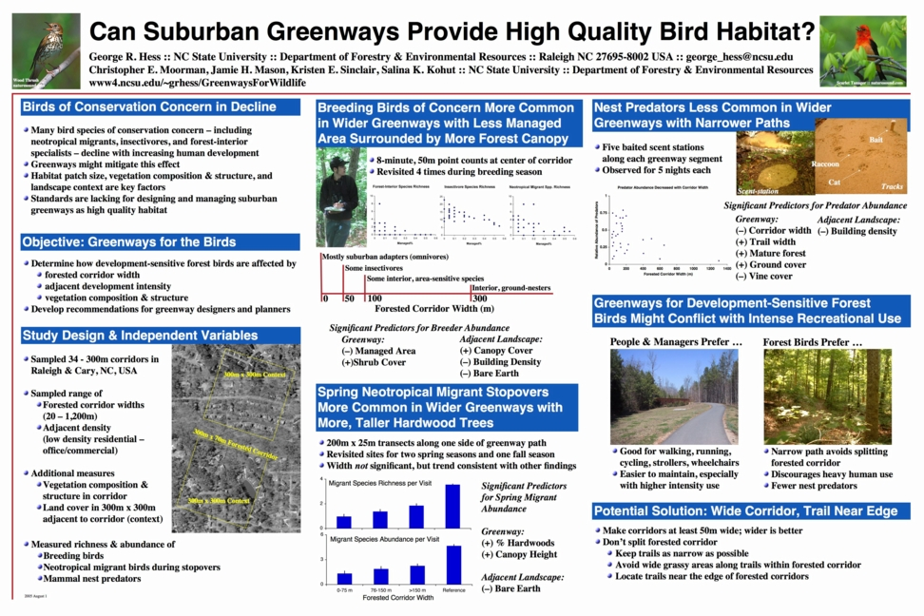
*Obtained from : Hess, G., Tosney, K., and Liegel, L. Creating Effective Poster Presentations,
http://www.ncsu.edu/project/posters/NewSite/CreatePosterLayout.html.

Slide 28
Better Research Poster in Less Time – New Poster Design (Poster 2.0) Sweeping the Conference Circuit
Developed by Mike Morrison (psychology grad student at Michigan State U.)
Frustration with perceived lack of efficiency of poster events for presenter and attendee prompted him to develop a sleek poster design.
New Poster Design –
  Main research finding in center in plain language and large font.
  QR code below where can find more info.
  Side panels for title, authors, byline and typical poster info.
For more information, see:
  How to create a better research poster in less time YouTube Video
  NPR (6/11/19 All Things Considered) “To Save the Science Poster, Researchers Want to Kill it and Start Over” article
  Poster 2.0 Templates and examples on Twitter

Slide 29


Slide 30
WVU Poster Resources
See https://undergraduateresearch.wvu.edu/present-and-publish/presentation-opportunities/summer-undergraduate-research-symposium for more details (judging rubrics, etc) about the Summer Symposium.
How to Prepare for a Poster Session by WVU’s Ian Harmon: https://libguides.wvu.edu/c.php?g=903129&p=6500445
Poster Printing Info at WVU Libraries: https://lib.wvu.edu/services/printing/poster/
WVU’s SpeakWrite Website: http://speakwrite.wvu.edu/

Slide 31
Good Poster Websites
Humorous Advice on Designing Conference Posters by Colin Purrington (Swarthmore College): https://colinpurrington.com/tips/poster-design/
Impactful Scientific Posters (ACS): https://www.youtube.com/watch?time_continue=215&v=J-SRWog-5Is
Designing Effective Research Posters by Justin Matthews (California State University, Monterey Bay): http://graduatestudent.ucmerced.edu/jmatthews/Site/Designing_Effective_Research_Posters.html
Creating Effective Poster Presentations by George Hess, Kathryn Tosney and Leon Liegel (NC State University):http://www.ncsu.edu/project/posters/ & 60-Second Poster Evaluation by George Hess (NCSU): https://projects.ncsu.edu/project/posters/60second.html
Humanities Poster Tips (from NYU): https://wp.nyu.edu/archivesandpublichistory/2014/05/13/poster-tips-for-humanities-conference-posters/
Posters for Humanities and Social Sciences by Aimee Roundtree (UHD): https://www.uhd.edu/academics/sciences/scholars/Documents/workshop-poster.pdf
Giving an Effective Poster Presentation: https://www.youtube.com/watch?time_continue=606&v=vMSaFUrk-FA
Great collection of Flickr posters, some good and some bad: http://www.flickr.com/groups/368476@N21/pool/

Slide 32
Overall Poster Should Be…
Focused
Coherent
Ordered
Visual
Graphic
Poster is expanded and visual form of abstract!
Poster should stand alone and tell your research story without you present AND with minimum words!

Slide 33
Friday July 26th is the last day of summer research for many of you. Before you leave, be sure to thank:
your faculty research mentor,
secondary mentors (graduate students, postdocs, etc.) with whom you have worked, and
any other folks who have helped you in your summer research.
Remember: Faculty who mentor undergraduates in research/creative work consider it an opportunity to train and enable the next generation to carry on the enterprise of scholarly activity in their field.
Notes:
Faculty and secondary mentors do not mentor undergraduates for the money, but rather for the opportunity to teach the next generation to carry on the research enterprise.

